Slide 1

Breast Cancer detection (IDC)
(Using deep learning)
Teamwork
Ahmed Mohamed Mahrous
Ahmed Hany
Ahmed Ayman Mansour
Sameh Salah
Mohamed Mesbah
Abdelkallek Harbi
Under supervision of
Dr / Amr Abd-Ellatif

Slide 2
Abstract
Inasive ductal carcinoma (IDC) is - with ~ 80 % of cases - one of the most common types of breast cancer. It's malicious and able to form metastases which makes it especially dangerous. Often a biopsy is done to remove small tissue samples. Then a pathologist has to decide whether a patient has IDC, another type of breast cancer or is healthy. In addition sick cells need to be located to find out how advanced the disease is and which grade should be assigned. This has to be done manually and is a time consuming process. Furthermore the decision depends on the expertise of the pathologist and his or her equipment. Therefor deep learning could be of great help to automatically detect and locate tumor tissue cells and to speed up the process. In order to exploit the full potential one could build a pipeline using massive amounts of tissue image data of various hospitals that were evaluated by different experts. This way one would be able to overcome the dependence on the pathologist which would be especially useful in regions where no experts are available.

Slide 3
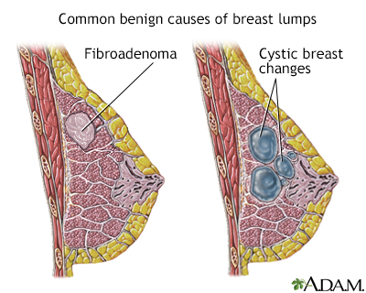
Introduction
Breast cancer is the second leading cause of cancer deaths among U.S. women, it is a type of cancer that starts when cells begin to grow out of control Most breast cancers begin in the ducts that carry milk to the nipple (ductal cancers), Breast cancer can spread when the cancer cells get into the blood or lymph system and are carried to other parts of the body. Cancerous breast tumors are detected by a special type of examination, which is screening mammogram

Slide 4
Project Headlines
Problem: Suffering from breast cancer
Objective: building a system for breast cancer detection using deep learning
Data: screening mammograms images
Technique: Using Deep Learning (CNN)

Slide 5
Details about the Dataset
The structure of the data:
279 files for each patient named with their id, and each file contains mammograms images of its owner
To facilitate the process of dealing with screening mammograms images, we will collect all the images in one place “all_rays_dir ”, while retaining ownership of each image and its class as well...
Then, we obtained 277,524 images!

Slide 6
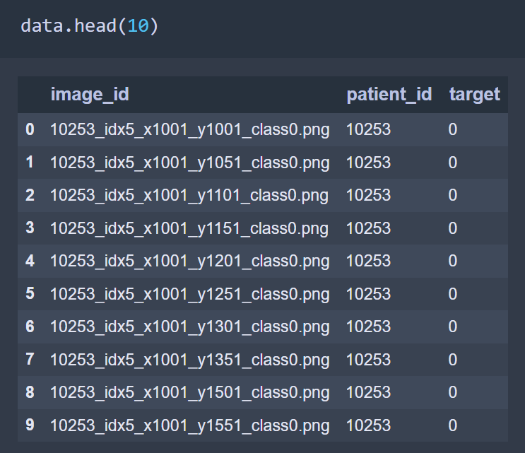
Then, it's time to put images in a data frame for easy access.

Slide 7
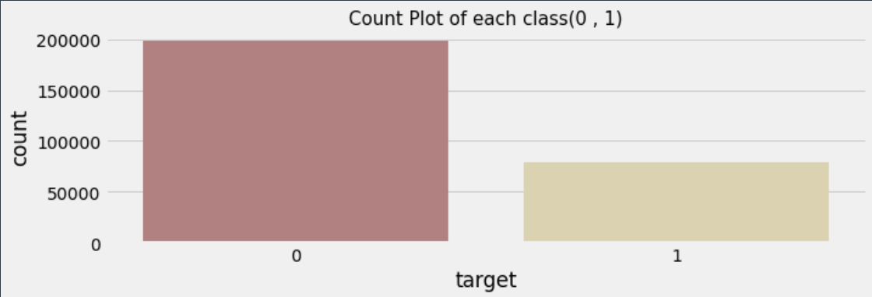
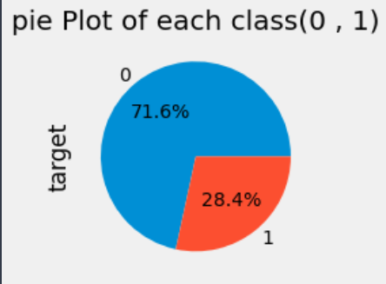
How many Healthy and Cancered mammograms are in the data?
Number of class (0) 198738
Number of class (1) 78786
It also seems that the number of healthy rays is greater than the number of infected rays

Slide 8
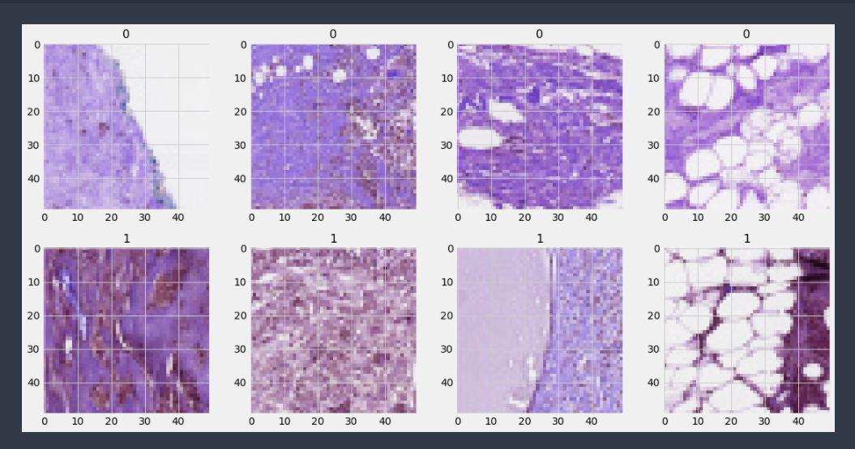
Healthy patches
let's take a look at the nature of mammograms
Cancer patches

Slide 9
Insights:
Most of the healthy mammograms are light pink, but there are some dark ones too.
Patches with cancer look more violet and crowded than healthy ones.
In fact, we could not determine the actual difference between the two types with the naked eye, but I think that the model is able to detect hidden patterns in these images that enable us to determine the state of each image.

Slide 10
Data Preprocessing
We can see that the class 0 images are higher in number that of class 1 to prevent this we unbalance the dataset
We take a sample of class 0 (total = 78786) & class 1 (total = 78786)
Then Creating train and test sets (test size = 10%)
We make train & Val batch size = 10
We make Rescaling to our data to speed up the training process
We use class mode='binary‘ because our target are 0 or 1 only

Slide 11
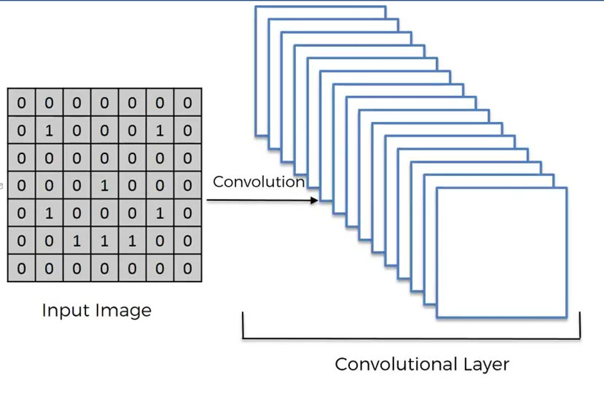
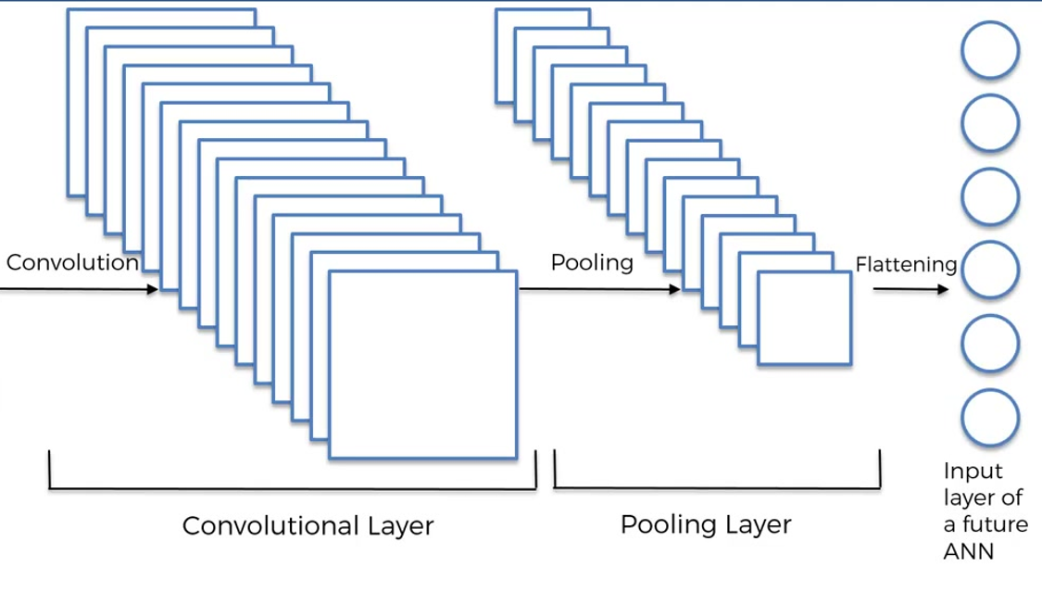
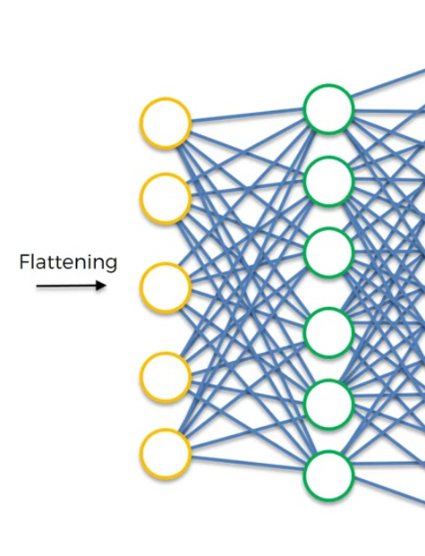
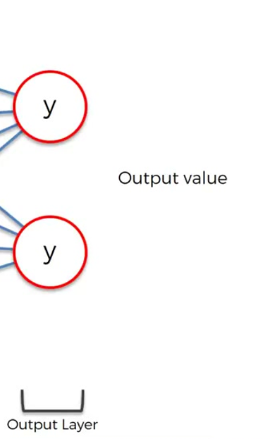
Model design
First CNN Layer
filters: 32
kernel size:4
padding: same
activation: relu
input shape: (25, 25, 3)
Second CNN Layer and max pool layer
filters: 32 pool size: 2
kernel size:4 strides: 2
padding: same padding: valid
activation: relu Dropout: 0.3
input shape: (25, 25, 3)
Adding the Flatten layer
Adding the first Dense layer with (neurons: 256 activation: relu)
Adding the second Dense layer (output layer)
neurons: 2 (number of classes) activation: softmax

Slide 12
Code For The Model
my_model =Sequential()
my_model.add(Conv2D(filters=32,kernel_size=(4,4),input_shape=(25,25,3),activation='relu'))
my_model.add(Conv2D(filters=32,kernel_size=(4,4),input_shape=(25,25,3),activation='relu'))
my_model.add(MaxPool2D(pool_size=(2,2)))
my_model.add(Dropout(.3))
my_model.add(Flatten())
my_model.add(Dense(256,activation='relu'))
my_model.add(Dense(2,activation='softmax'))
my_model.compile(loss = 'binary_crossentropy', optimizer ='adam', metrics= ['accuracy'])

Slide 13
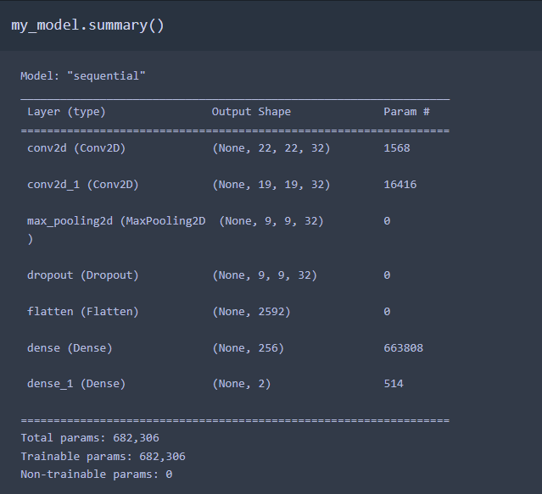
Model Summary

Slide 14
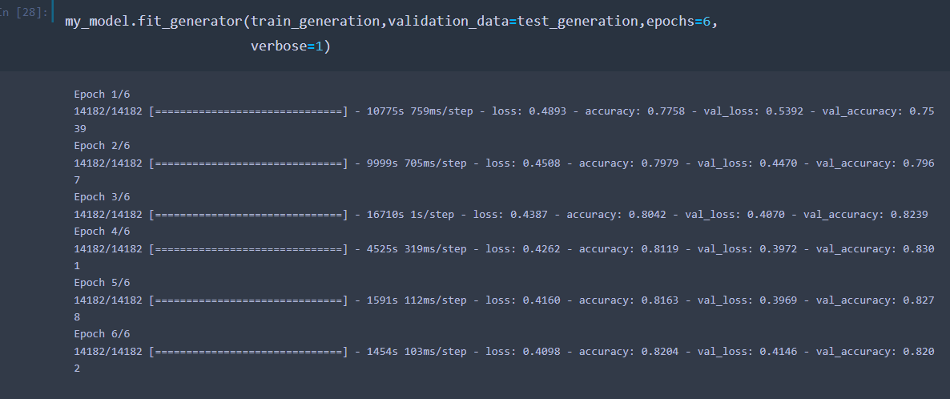
Model fitting

Slide 15
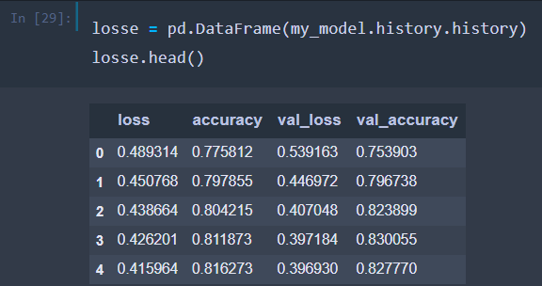
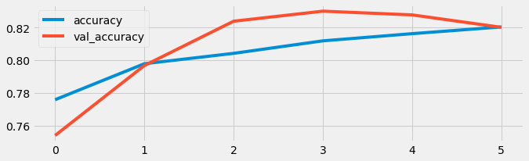
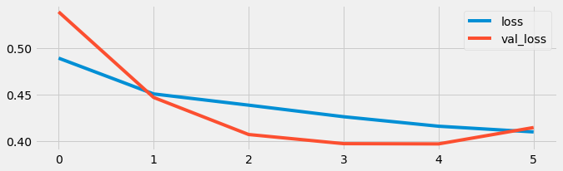
Test
History of model :

Slide 16
Model Outputs
Model Evaluation :
Val Loss = 0.4146
Val accuracy = 0.8202
After several attempts, we made a good model design but we will try to improve accuracy
Our model have a good accuracy= 82.02 %
over fitting is so small
The model took 12.34 hours to train
Run on CPU
The environment : Jupyter Notebook

Slide 17
Thanks for Listening!

